Slide 1
Cell-List based Molecular Dynamics on Many-Core Processors: A Case Study on Sunway TaihuLight Supercomputer
Xiaohui Duan
Notes:
简单介绍题目和作者

Slide 2
BACKGROUND

Slide 3
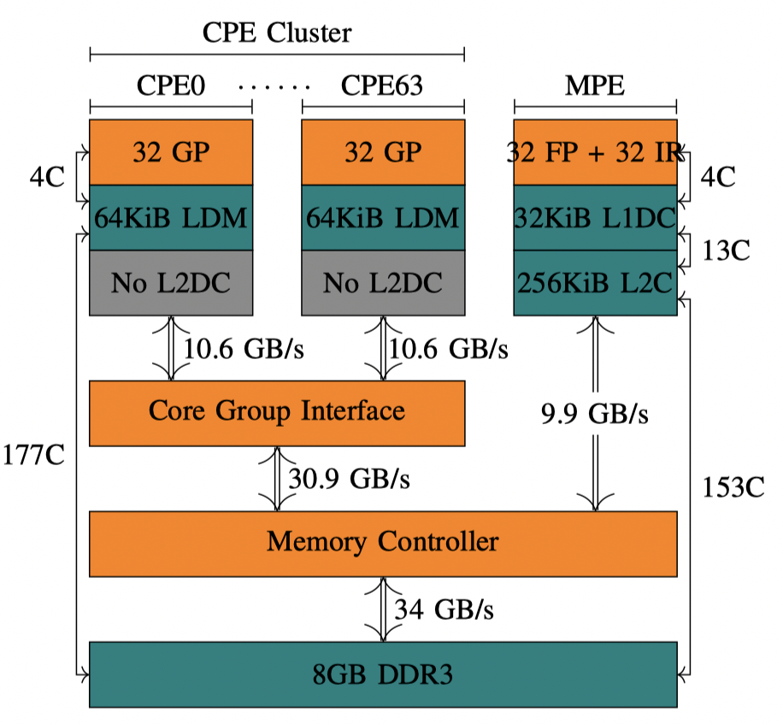
Sunway TaihuLight Supercomputer
SW26010
Notes:
科普一下神威太湖之光，其实跟这个文章没有太大关系
4个CG，每个CG有一个主核，64个从
核，8G内存
自动缓存与手动缓存64KB
DMA和ld
从核通信

Slide 4
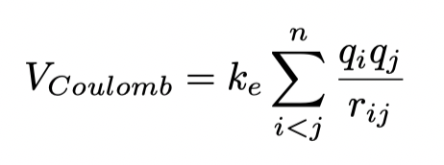
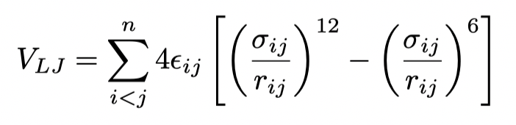
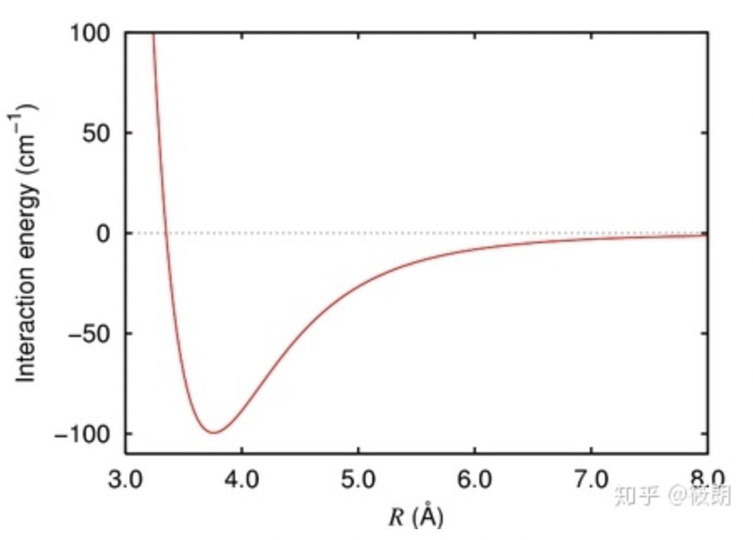
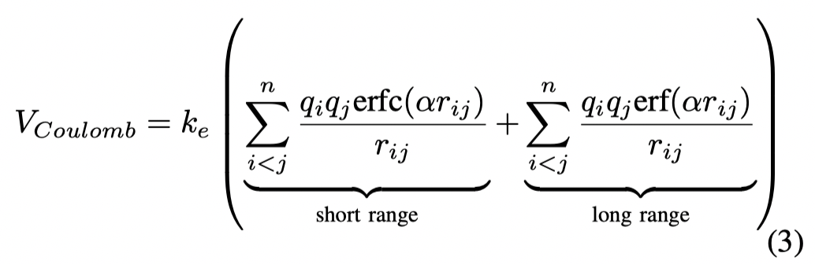
Molecular dynamics (MD) simulations
the Particle-Mesh Ewald method
Notes:
分子动力学模拟，文章中的介绍也很少
其实是只介绍了两个力：
范德华力（分子间作用力）
库仑力（）
平方反比

Slide 5
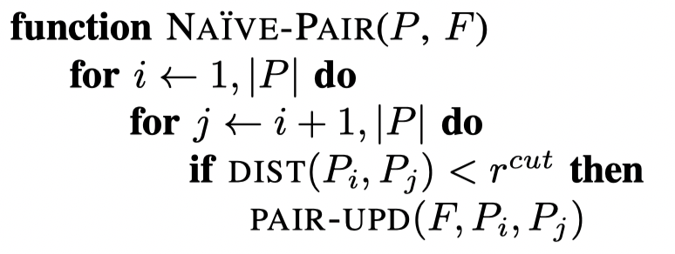
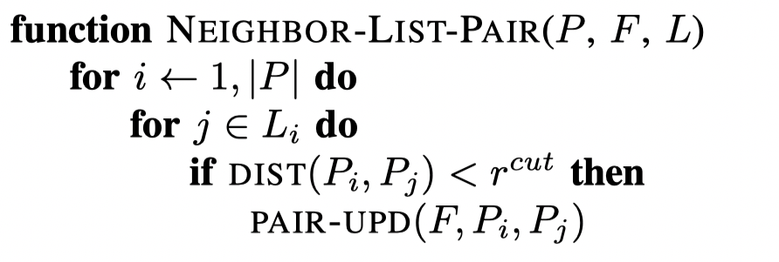
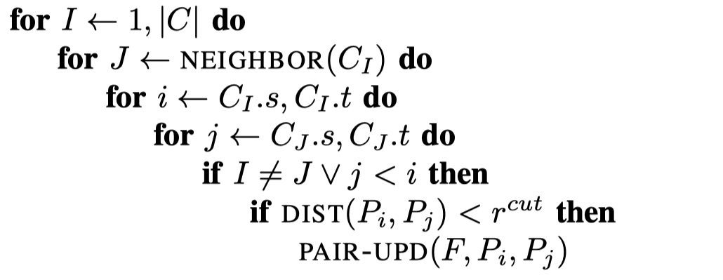
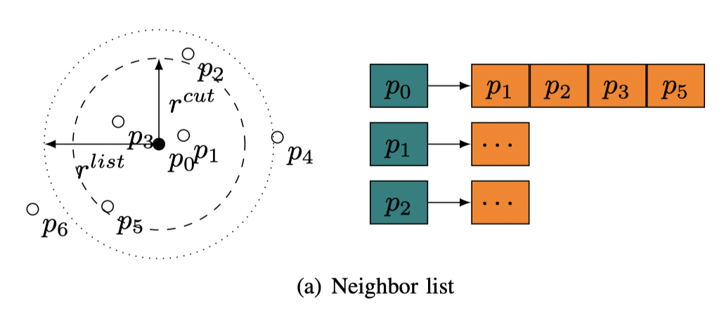
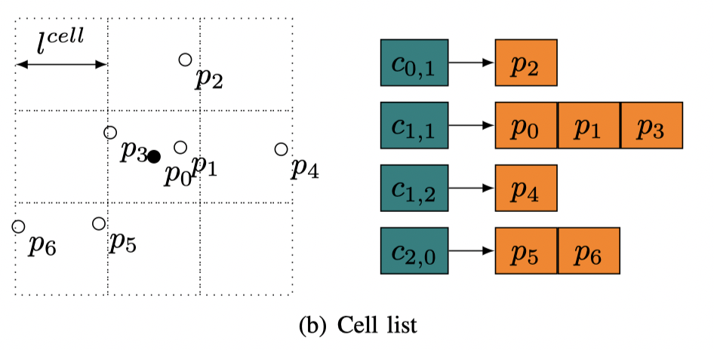
Computation of Pair-wise Interactions
Naive
Neighbor-List
Cell List

Slide 6
OPTIMIZATION METHODS

Slide 7
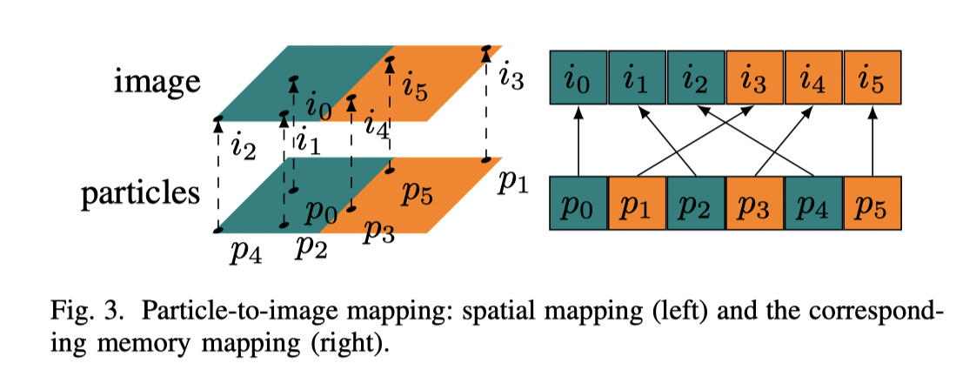
Optimization based on pmemd’s Nonbonded Kernel
同一个Cell的点存在一起，有更好的局部性

Slide 8
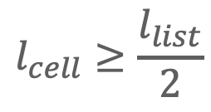
Cell-wise Interactions based on Images
$$l_{cell}≥\frac{l_{list}}{2}$$
利用牛顿第三定理，两个点对之间只需要计算一次力，减小计算量，引入写冲突问题。

Slide 9
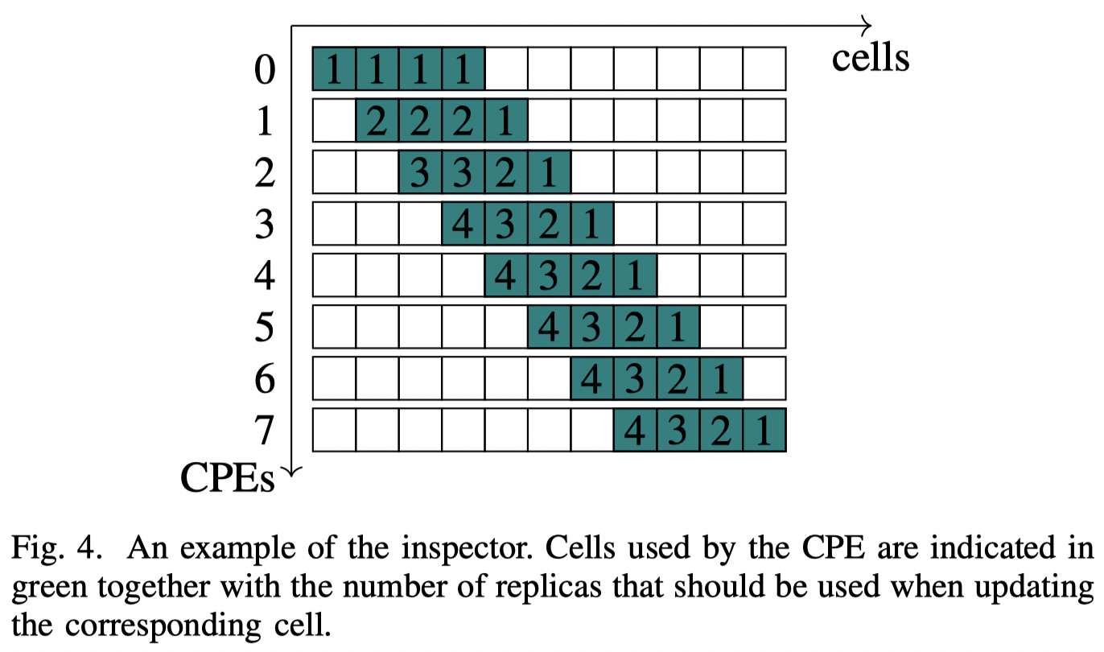
Adaptive Replica Summation
0 1 2 3 4 5 6 7 8 9 10
avoid write conﬂits
full-replica-summation
disabling Newton’s 3rd law
Adaptive Replica Summation
Inspector-executor scheme

Slide 10
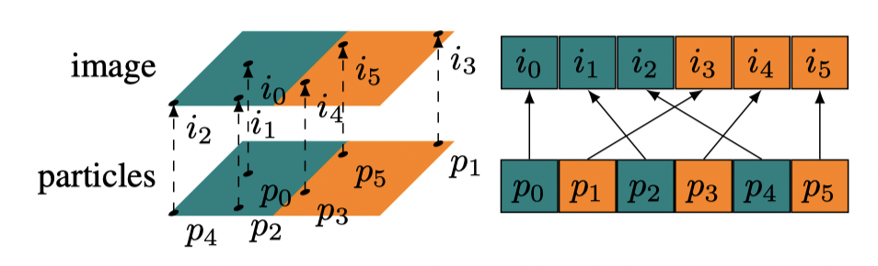
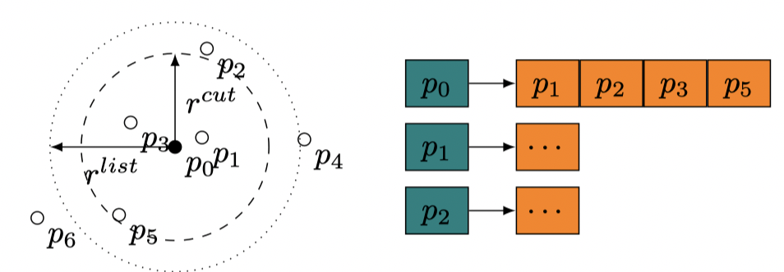
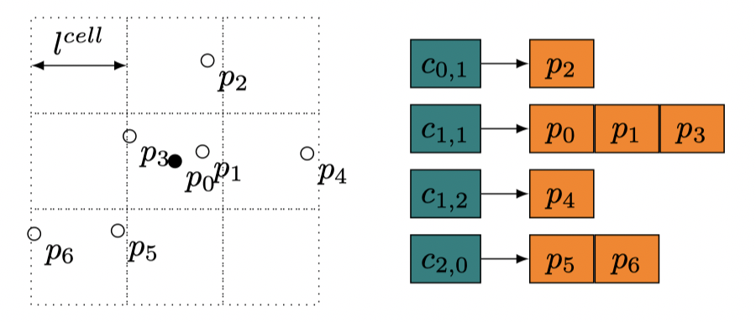
Vectorization of Cell-wise Interactions
Problem：
Indirect addressing from neighbor lists
Indirect addressing from particle types
Divergence

Slide 11
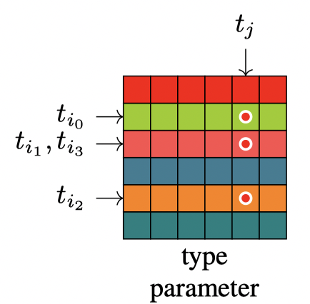
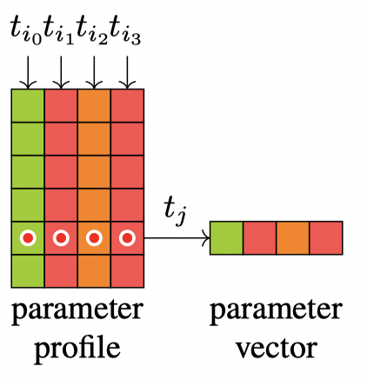
Vectorization of Cell-wise Interactions
Problem：
Indirect addressing from neighbor lists
Indirect addressing from particle types
Divergence
Cell List

Slide 12
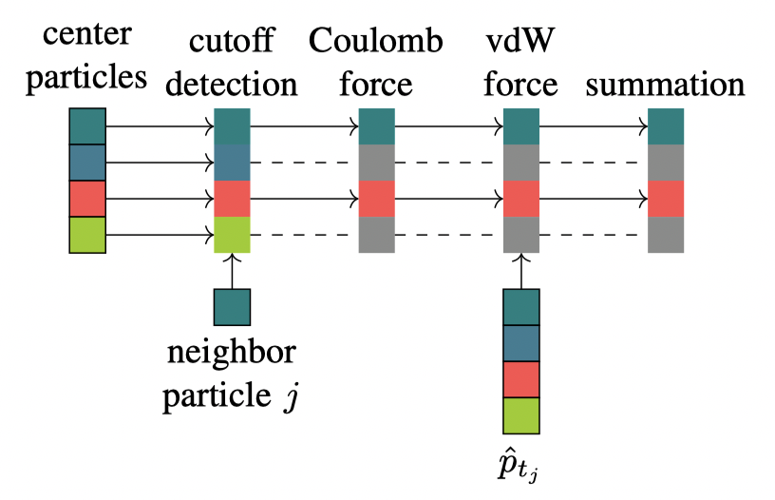
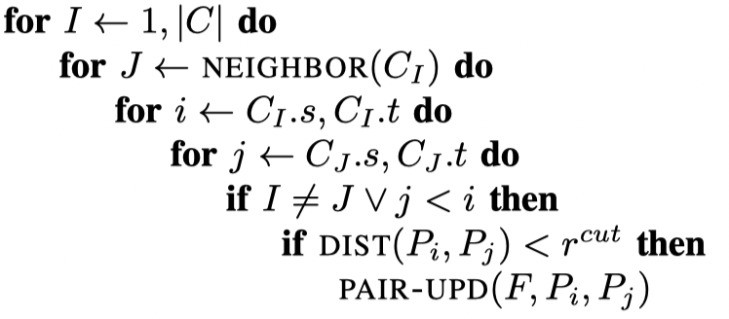
Vectorization of Cell-wise Interactions
Problem：
Indirect addressing from neighbor lists
Indirect addressing from particle types
Divergence
/home/hp200266/u01036/gzq/fj_software/tensorflow/TensorFlow-2.2.0/include
Solution：
Shortcuts
Sorting particles（Hilbert space-ﬁlling curve）

Slide 13
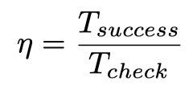
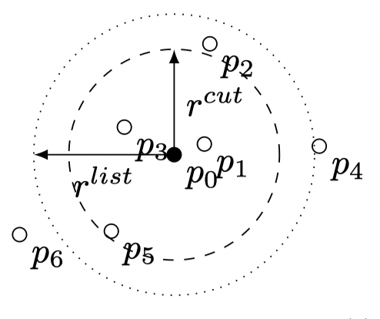
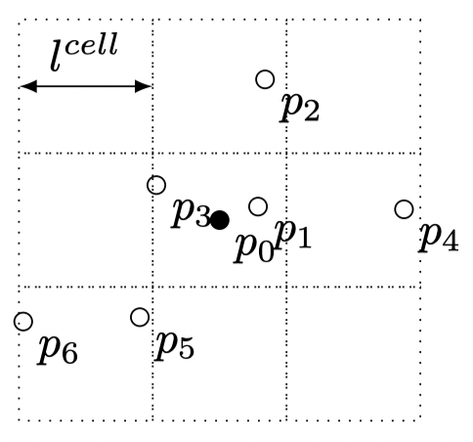
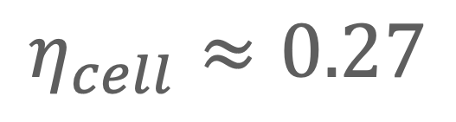
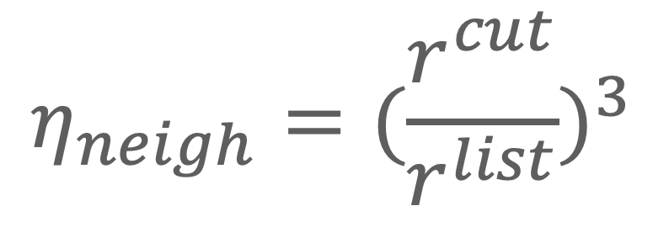
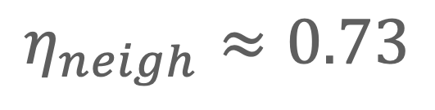
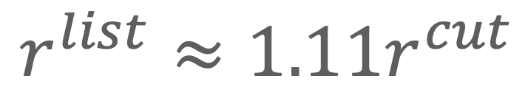
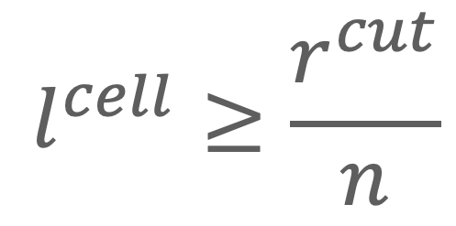
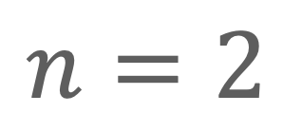
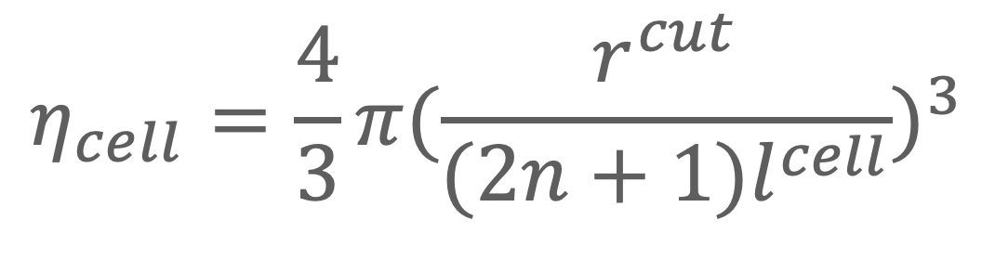
Particle-cell Cutoff Checking Filter
问题：cell-based 方法有更多的多余的检测。
假设粒子在空间中均匀分布：
$$η_{neigh}=(\frac{r^{cut}}{r^{list}})^{3}$$
$$r^{list}≈1.11r^{cut}$$
$$η_{neigh}≈0.73$$
$$η_{cell}=\frac{4}{3}π(\frac{r^{cut}}{(2n+1)l^{cell}})^{3}$$
$$l^{cell}≥\frac{r^{cut}}{n}$$
$$n=2$$
$$η_{cell}≈0.27$$

Slide 14
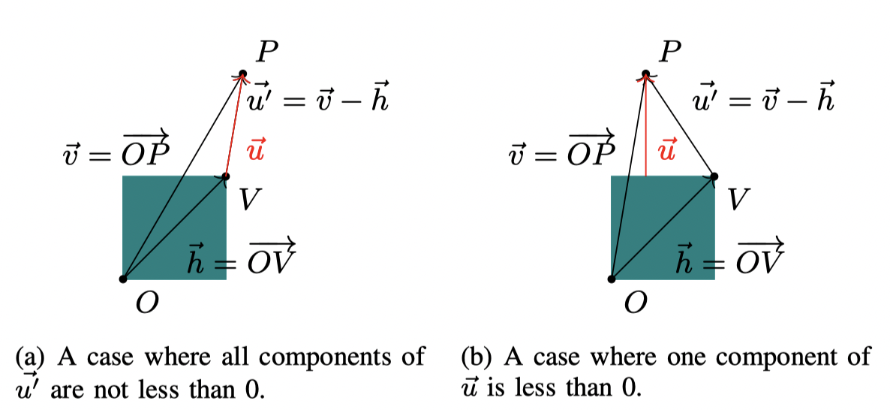
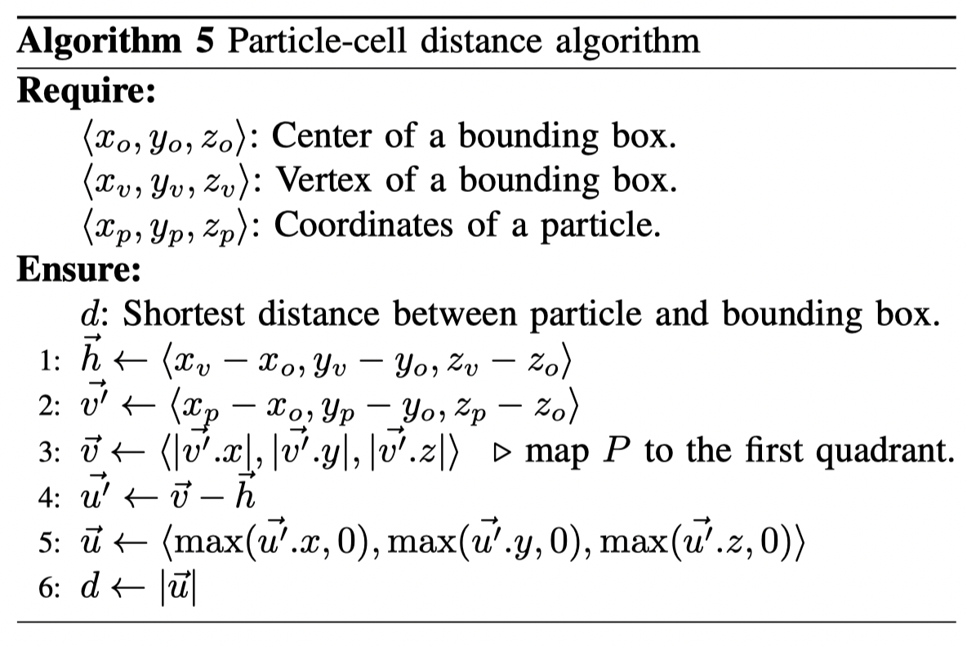
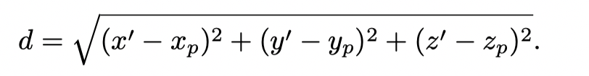
Particle-cell Cutoff Checking Filter

Slide 15
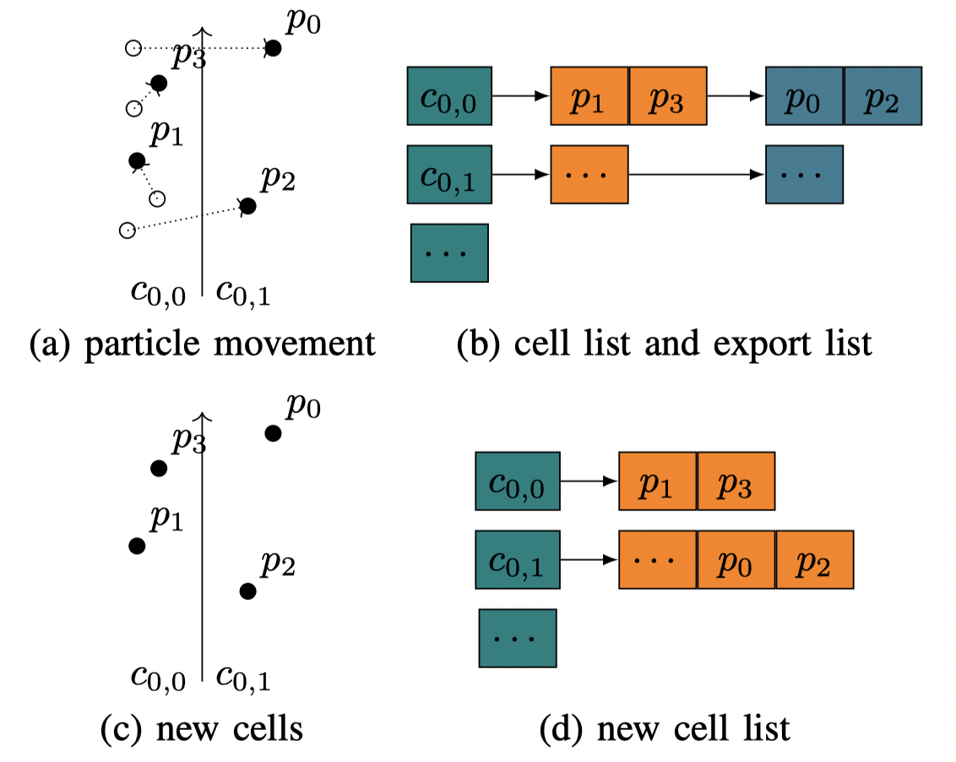
Optimizations of ESMD
a standalone framework for a minimum set pair-wise interactions
Incremental Cell List Building：
该方法基于一个发现：粒子只会移动到相邻的cell
two stage：
export stage
import stage
Cell-based Packing：
MPI进程间通信，Cell List打包

Slide 16
PERFORMANCE EVALUATION

Slide 17
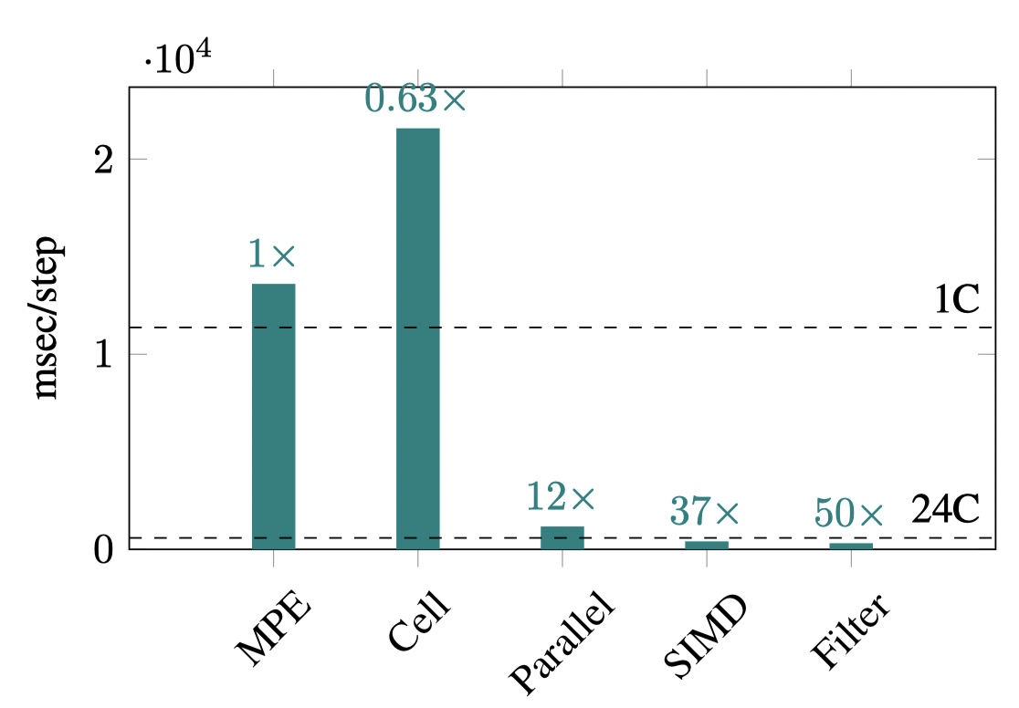
Incremental performance evaluations with different optimization techniques on a single TaihuLight node

Slide 18
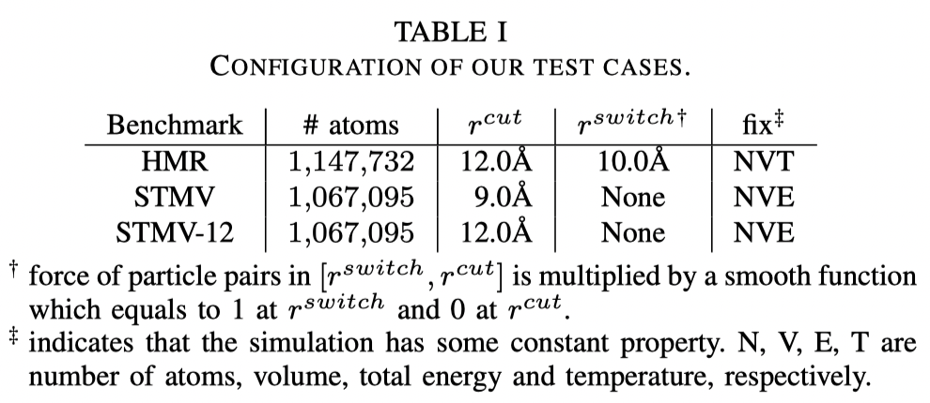
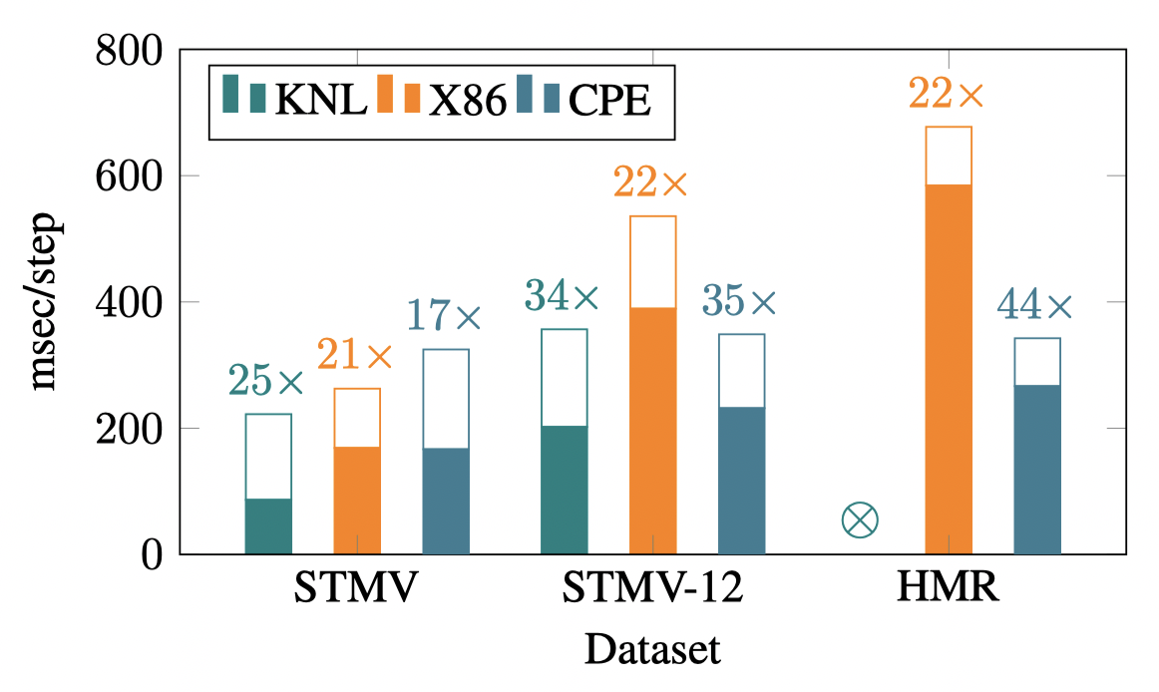
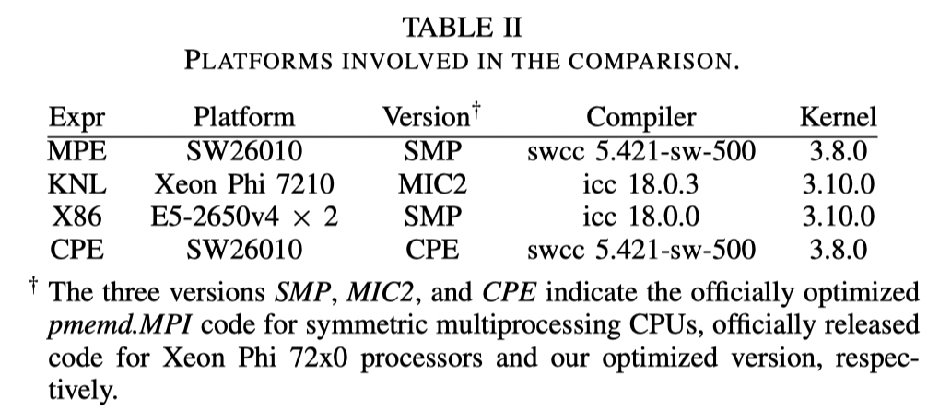
Performance comparison to other platforms
Cutoff 较短时没有优势，由于多次的image building和small bucket size

Slide 19
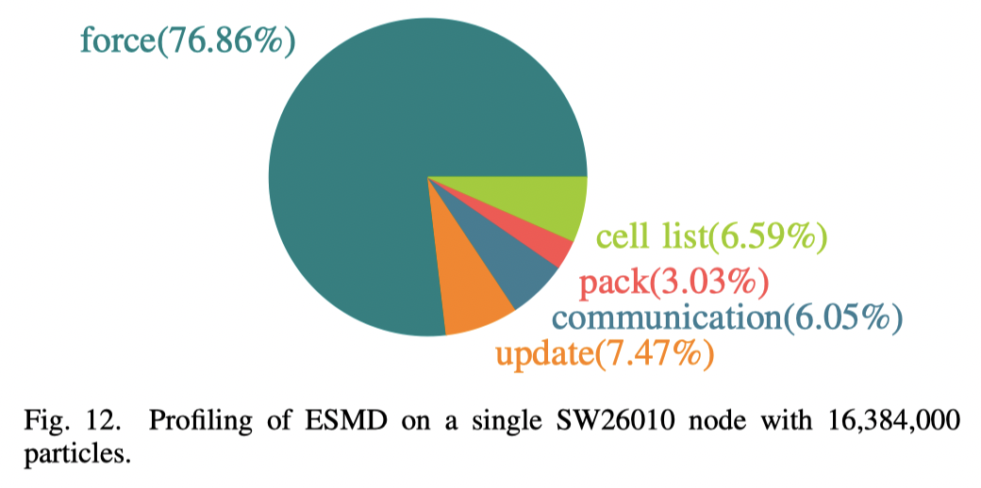
Proﬁling of ESMD

Slide 20
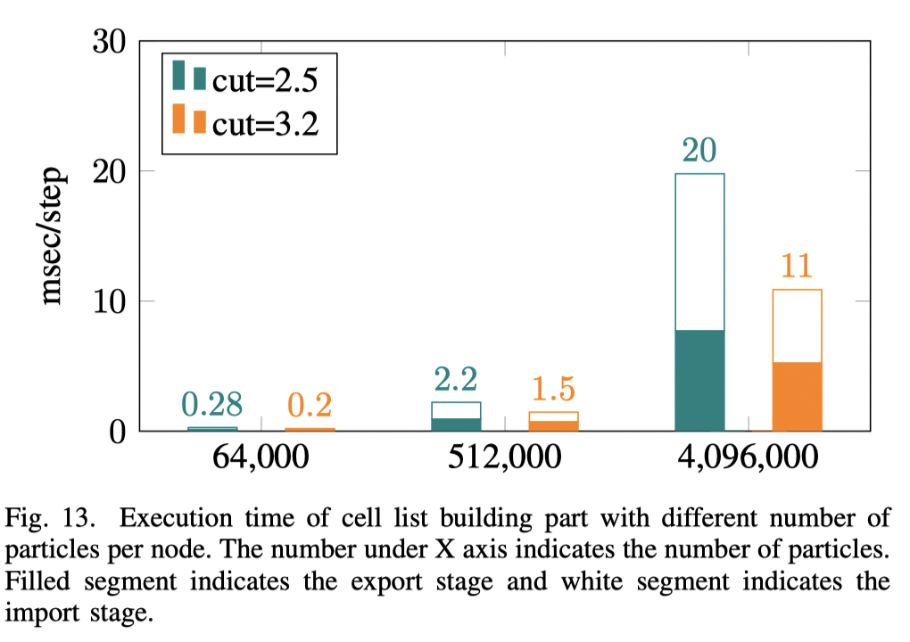
cutoff distance
Cell 越大，粒子移动到其他Cell的机会越小。Cell building 开销也越小

Slide 21
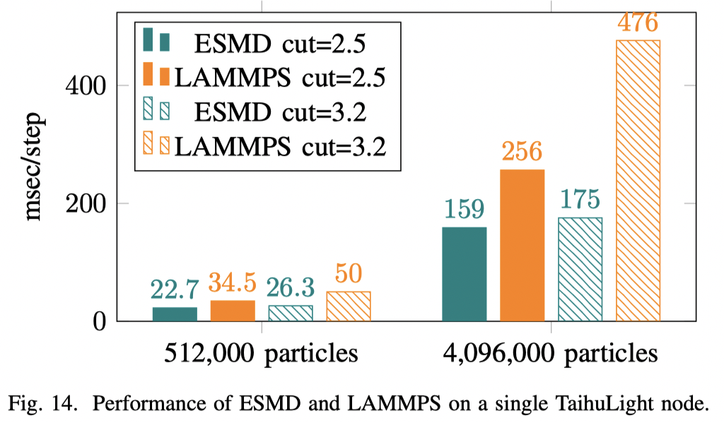
Performance of ESMD and LAMMPS

Slide 22
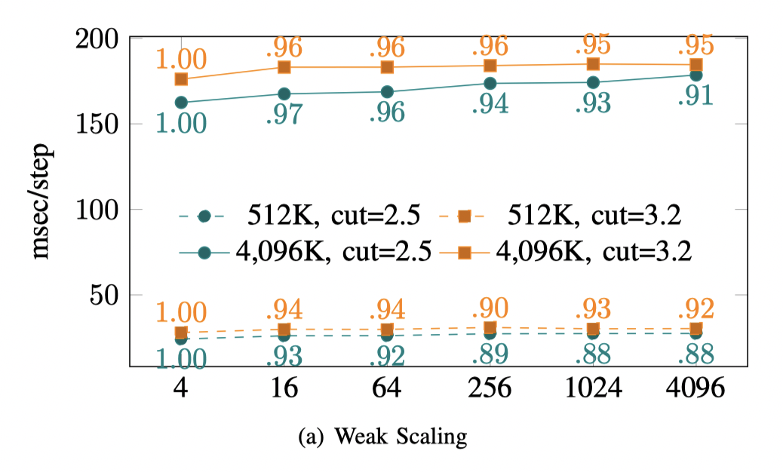
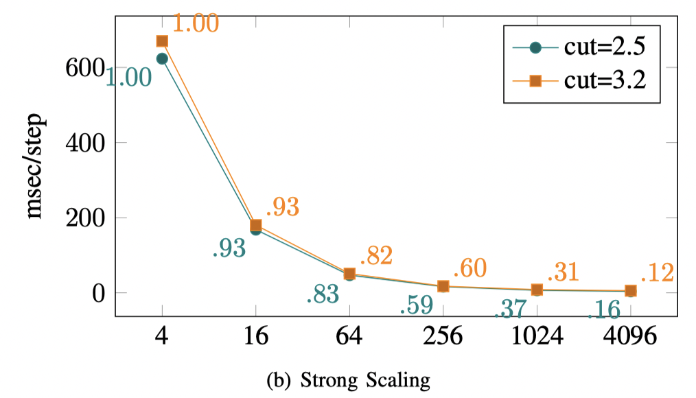
Scalability

Slide 23
SUMMARY

Slide 24
Summary
短程力的计算：
Cell List Based method：有更好的局部性，但是增加了额外的无效粒子。
牛顿第三定律：一个点对之间只计算一次力，更新两个粒子的受力，减少了计算，引入写冲突问题。
adaptive replica-summation：方法实现冲突避免，提高并行效率。
parameter proﬁle：解决不同类型粒子参数的向量化读取
Shortcuts + Sorting particles：减少向量化中的无效分支计算。
Particle-cell Cutoff Checking Filter：过滤掉对于某个粒子没有必要计算的Cell
ESMD：点对之间计算受力的独立框架
Incremental Cell List Building：粒子运行之后快速重建新的Cell List
Cell-based Packing：多节点中Cell List维护

